Slide 1
Applied Time Series Analysis
FISH 507
Eric Ward
Mark Scheuerell
Eli Holmes

Slide 2
Introductions
Who are we?
Who & why you’re here?
What are you looking to get from this class?

Slide 3
Days and Times
Lectures
When: Tues & Thurs from 1:30-2:50
Where: FSH 203
Computer lab
When: Thurs from 3:00-3:50
Where: FSH 207

Slide 4
Grading
Weekly homework (30% of total)
Assigned Thurs at the end of computer lab
Due by 5:00 PM the following Tues
Based on material from lecture & computer lab
Research project & paper (40% of total)
Must involve some form of time series model(s)
Due by 11:59 PM PST on March 10
Two anonymous peer-reviews (20% of total)
One review each for 2 colleague’s papers
Due by 11:59 PM PST on March 16

Slide 5
Expectations for final project
Research paper or thesis chapter that you can turn into a peer-reviewed publication
Ideally a solo effort, but you can work in pairs
Focus on applied time series analysis
Univariate or multivariate
Short format similar to “Report” in Ecology or “Rapid Communication” in CJFAS
Max of 20 pages, inclusive of refs, tables, figs, etc
12-pt font, double-spaced throughout

Slide 6
Don’t have any time series data?
RAM Legacy
http://ramlegacy.marinebiodiversity.ca/
RAM’s Stock-Recruitment Database
http://www.mscs.dal.ca/~myers/welcome.html
Global Population Dynamics Database
http://www3.imperial.ac.uk/cpb/databases/gpdd
NOAA NWFSC Salmon Population Summary
https://www.webapps.nwfsc.noaa.gov/apex/f?p=261:home:0
SAFS
Alaska Salmon Program
Lake Washington plankton

Slide 7
Course topics
Week 1: Decomposition, covariance, autocorrelation
Week 2: Autoregressive & moving-average models, model estimation
Week 3: Univariate & multivariate state-space models
Week 4: Covariates & seasonal effects; model selection
Week 5: Dynamic linear models
Week 6: Forecasting & dynamic factor analysis
Week 7: Multistage & non-Gaussian models
Week 8: Detection of outliers & perturbation analysis
Week 9: Spatial effects & hierarchical models
Week 10: Presentations of final projects

Slide 8
An introduction to time series and their analysis
Mark Scheuerell
FISH 507 – Applied Time Series Analysis
3 January 2017

Slide 9
Topics for today (lecture)
Characteristics of time series (ts)
What is a ts?
Classifying ts
Trends
Seasonality (periodicity)
Classical decomposition

Slide 10
What is a time series?
A time series (ts) is a set of observations taken sequentially in time
A ts can be represented as a set
{x_{t} : t = 1,2,3,…,n} = {x₁,x₂,x₃,…,x_{n}}
For example,
{10,31,27,42,53,15}

Slide 11
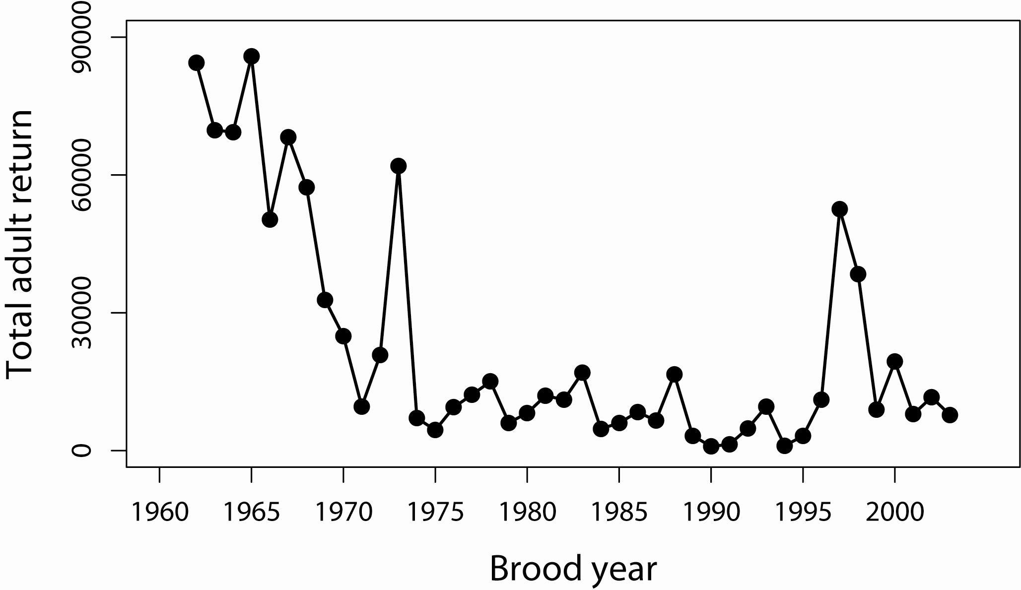
Example of a time series
Number of wild spr/sum Chinook salmon returning to the Snake R

Slide 12
Classification of time series (I)
By some index set
Interval across real time x(t); t ∈ [1.1,2.5]
Discrete time x_{t}
Equally spaced; t = {1,2,3,4,5}
Equally spaced w/ missing values; t = {1,2,4,5,6}
Unequally spaced; t = {2,3,4,6,9}

Slide 13
Classification of time series (II)
By underlying process
Discrete (eg, total # of fish caught per trawl)
Continuous (eg, salinity, temperature)

Slide 14
Classification of time series (III)
By number of values recorded
Univariate/scalar (eg, total # of fish caught)
Multivariate/vector (eg, # of each spp of fish caught)

Slide 15
Classification of time series (IV)
By type of values recorded
Integer (eg, # of fish in 5 min trawl = 2413)
Rational (eg, fraction of unclipped fish = 47/951)
Real (eg, fish mass = 10.2 g)
Complex (eg, cos[2π*2.43] + i sin[2π*2.43])

Slide 16
Statistical analyses of time series
Most statistical analyses are concerned with estimating properties of a population from a sample
Time series analysis, however, presents a different situation
Although we could vary the length of an observed sample, it is often impossible to make multiple observations at a given time
For example, one can’t observe today’s closing price of Microsoft stock more than once
This makes conventional statistical procedures, based on large sample estimates, inappropriate

Slide 17
Examples of time series
flat
increasing
decreasing
increasing
How would we describe this ts?

Slide 18
Examples of time series
“Regular” cycle
How would we describe this ts?

Slide 19
What is a time series model?
A time series model for {x_{t}} is a specification of the joint distributions of a sequence of random variables {X_{t}} of which {x_{t}} is thought to be a realization
For example,
“white” noise: x_{t} = w_{t} and w_{t} ~ N(0,1)
autoregressive: x_{t} = x_{t-1} + w_{t} and w_{t} ~ N(0,1)

Slide 20
Iterative approach to model building
Also known as the “Box-Jenkins Approach”
Postulate general class of models
Identify candidate model
Estimate parameters
Diagnostics:
is model adequate?
Use model for forecasting or control
No
Yes

Slide 21
Classical decomposition of time series
Classical decomposition of an observed time series is a fundamental approach in time series analysis
The idea is to decompose a time series {x_{t}} into a trend (m_{t}), a seasonal component (s_{t}), and a remainder (e_{t})
x_{t} = m_{t} + s_{t} + e_{t}

Slide 22
Linear filtering of time series
Beginning with the trend (m_{t}), we need a means for extracting a “signal”
A common method is to use linear filters
For example, moving averages with equal weights
(FYI, this is what Excel does)

Slide 23
Example of linear filtering

Slide 24
Linear filtering of time series
Consider case where season is based on 12 months & ts begins in January (t=1)
Monthly averages over year will result in t = 6.5 for m_{t} (which is not good)
One trick is to average (1) the average of Jan-Dec & (2) the average of Feb-Jan

Slide 25
Example of linear filtering

Slide 26
Example of linear filtering
Data from http://www.ncdc.noaa.gov/

Slide 27
Example of linear filtering

Slide 28
Decomposition of time series
Now that we have an estimate of m_{t}, we can get estimate of s_{t} simply by subtraction:

Slide 29
Example of linear filtering

Slide 30
Decomposition of time series
Now that we have an estimate of s_{t}, we can get estimate of e_{t} simply by subtraction:

Slide 31
Example of linear filtering

Slide 32
Notes on decomposition
Obtaining a “model” for a ts via decomposition is easy, but…
You don’t get a formula with which to obtain forecasts
Let’s look at an alternative

Slide 33
Example of linear trend fitting
A simple method for trend extraction is to use linear regression
Note: the t index here could be a non-integer in cases with seasonal data

Slide 34
Example of linear trend fitting

Slide 35
Decomposition of time series
Another means for extracting a trend is via nonparametric regression models (eg, LOESS)
see R pkg stl

Slide 36
Moving on with decomposition
We have decomposed our time series into a trend plus remainder (s_{t} + e_{t})
x_{t} = (-135.6 + 0.0715t) + s_{t} + e_{t}
Now let’s consider the seasonal part

Slide 37
Example of linear trend fitting
One method is to use fixed effects (eg, ANOVA)

Slide 38
Example of linear trend fitting
Adding in a model for season (ie, quarters)
This is the “floor” function
So, for example, if q = 10.25:

Slide 39
Example of linear trend fitting
Our final decomposition model

Slide 40
Example of trend + season fitting

Slide 41
Are the residuals stationary?
The goal with decomposition is to reduce the time series to a trend, season & stationary residuals

Slide 42
Iterative approach to model building
Postulate general class of models
Identify candidate model
Estimate parameters
Diagnostics:
is model adequate?
Use model for forecasting or control
No
Yes

Slide 43
Summary
This was a brief overview—there is lots of stuff we didn’t cover
Please ask for help/guidance if you’re looking for more details, other R code, etc

